Slide 1
UNIVERSITI TUN HUSSEIN ONN MALAYSIA

Slide 2
IN THIS PRESENTATION:
Introduction
Where Are We Now
Engagement Strategies
Let’s Do Business!

Slide 3


INTRODUCTION

Slide 4
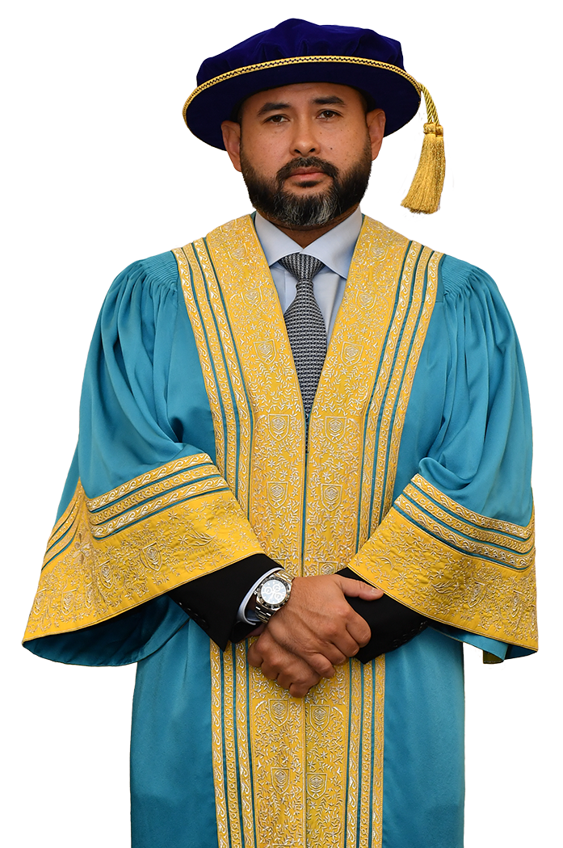
CHANCELLOR
HIS ROYAL HIGHNESS
TUNKU ISMAIL
The Regent of Johor

Slide 5
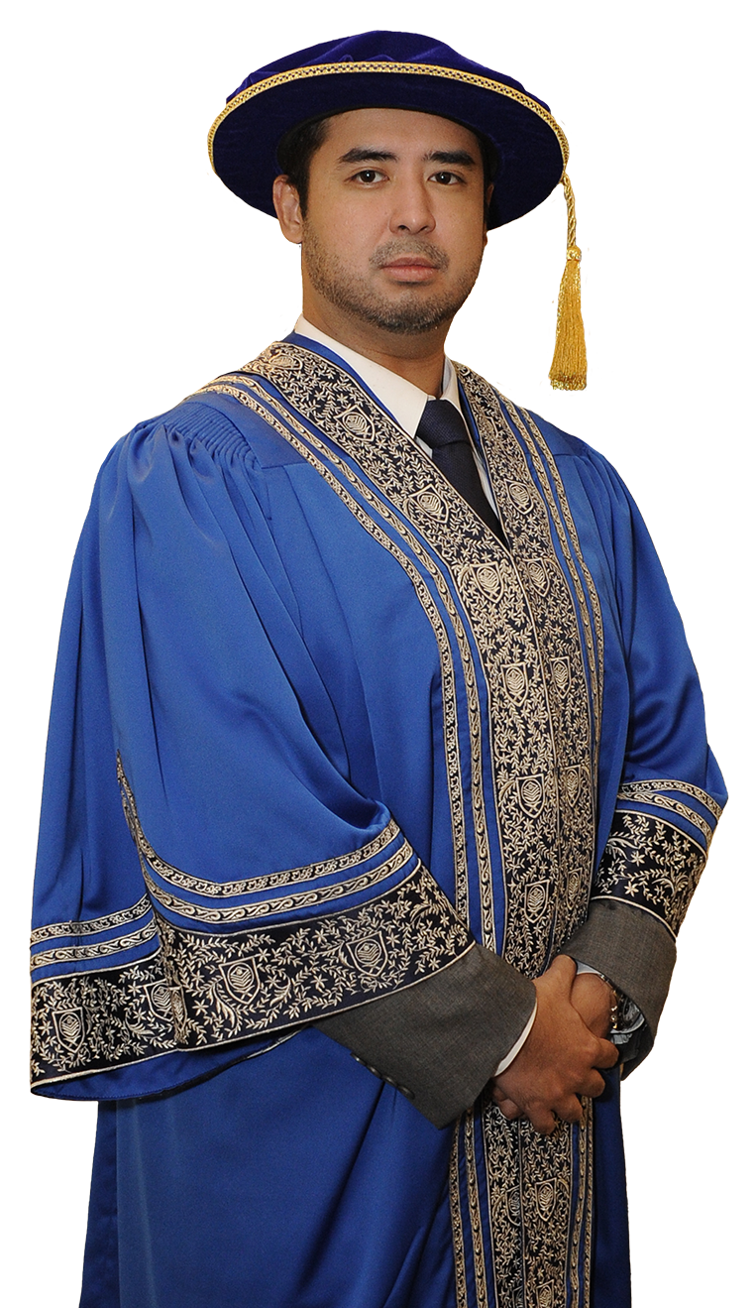
PRO-CHANCELLOR
HIS HIGHNESS
TUNKU IDRIS ISKANDAR
AL-HAJ IBNI SULTAN IBRAHIM
the Tunku Temenggong of Johor

Slide 6
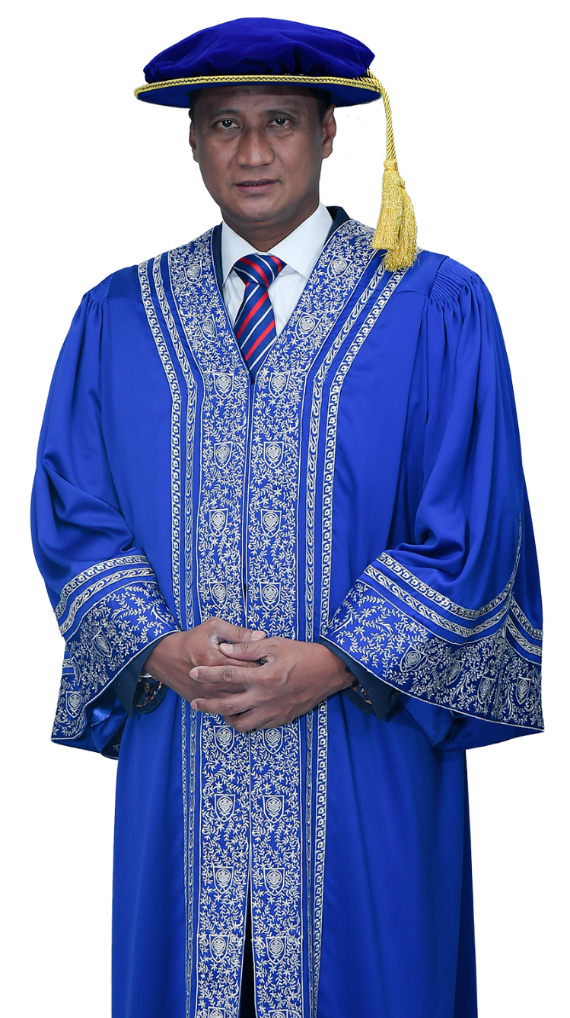
PRO-CHANCELLOR
YANG BERHORMAT
TAN SRI DATO’ Dr. HAJI AZMI
BIN ROHANI
State Secretary of Johor

Slide 7
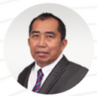

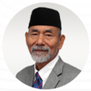
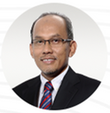
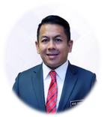
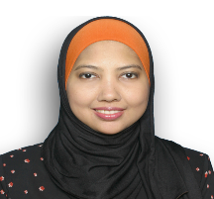
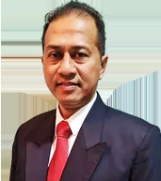
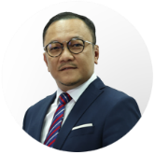
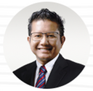
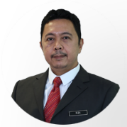
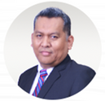
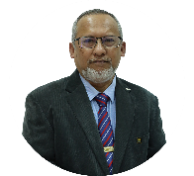
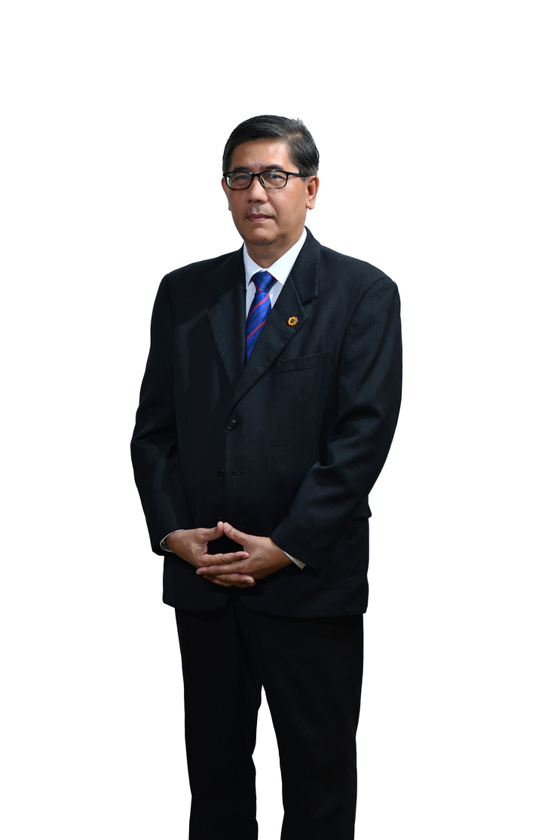
BOARD OF DIRECTORS
CHAIRMAN
YBhg. Dato' Sri Ibrahim bin Ahmad
MEMBERS
YB Prof. Dato’ Ir. Ts. Dr. Ruzairi bin Abdul Rahim
Vice-Chancellor
Universiti Tun Hussein Onn Malaysia
YB Dato' (Dr.) Haji Nooh bin Gadot
Advisor
Johor Islamic Religious Council
YBhg. Datuk Md Jais bin Haji Sarday
Board Member
Universiti Tun Hussein Onn Malaysia
YBhg. Dato' Dr. Mohd Sharil bin Abdullah
Director of Industrial Relations Division
Department of Higher Education, Ministry of Higher Education
YBrs. Puan Mahfuzah binti Baharin
Deputy Under-Secretary (Sector of Tax Incentive & Sectoral) TSBC(GCS)
Ministry of Finance
YBrs. Encik Hasry bin Harun
Chief Executive Officer
Malaysia Rail Development Corporation
YBhg. Datuk Haji Mohd Lassim bin Burhan
Board Member,
Universiti Tun Hussein Onn Malaysia
YBrs. Ir. Ts. Abdul Rahman Bahasa
Chief Executive Officer,
Recove Group
SECRETARY
YBrs. Mohamad Irza bin Dahari @ Zahari
Administration and Diplomatic Officer
Department Of Higher Education
Ministry of Higher Education
YBrs. Encik Shahril Anwar bin Mohd Yunos
Managing Partner,
Virtus Capital Partners
Sdn Bhd
YBhg. Prof. Ir. Dr. Mohd. Amri
bin Lajis
Professor
Universiti Tun Hussein Onn Malaysia
YBrs. Encik Naim bin Maslan
Registrar/Chief Operating Officer
Universiti Tun Hussein Onn Malaysia

Slide 8
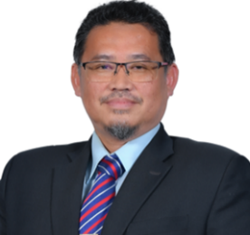
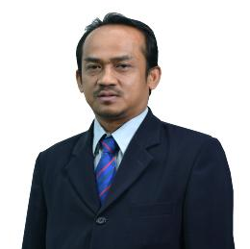
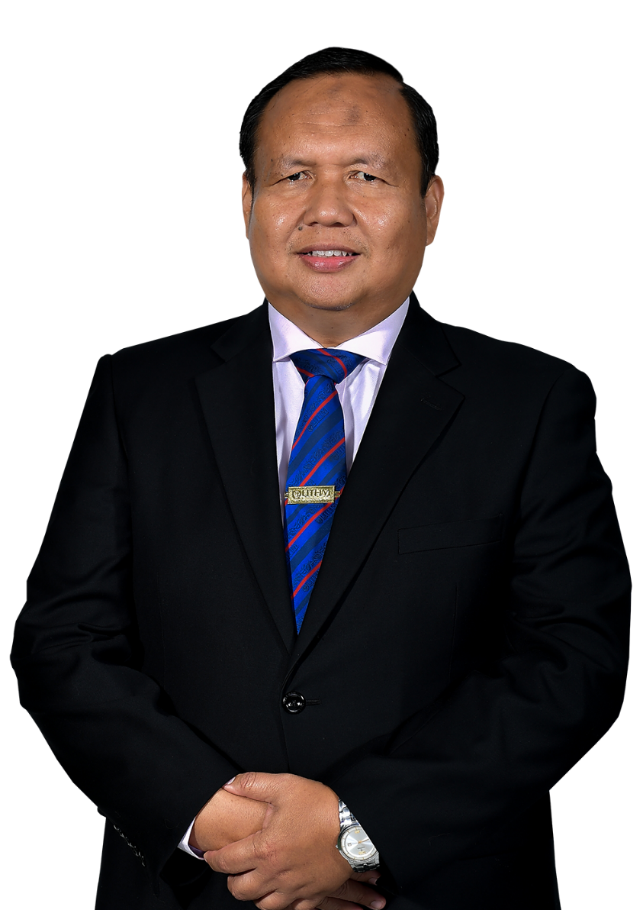
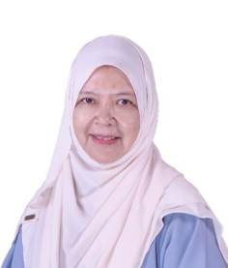
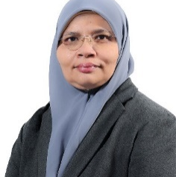
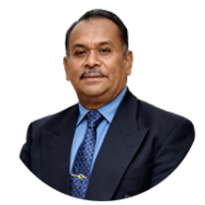
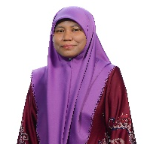
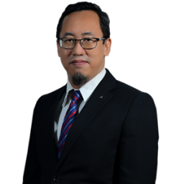
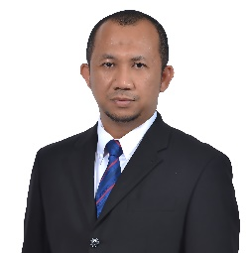
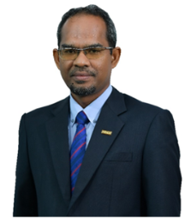
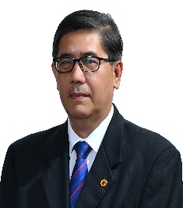
DEPUTY VICE CHANCELLOR (ACADEMIC & INTERNATIONAL)
BURSAR /
CHIEF FINANCIAL
OFFICER (CFO)
UTHM EXECUTIVES
COMITTEE
Prof. Dr. Shahruddin bin Mahzan @ Mohd Zin
Encik Norzaimi bin Hamisan
CHIEF LIBRARIAN
DEPUTY VICE CHANCELLOR (RESEARCH & INOVATION)
Puan Zaharah binti Abd Samad
Prof. Ts. Dr. Rabiah binti Ahmad
LEGAL ADVISOR
DEPUTY VICE CHANCELLOR
(STUDENT AFFAIRS & ALUMNI)
Puan Norliah binti Yaakub
Prof. Ts. Dr. Abdul Rasid bin Abdul Razzaq
VICE CHANCELLOR
ASSISTANT VICE CHANCELLOR (STRATEGIC & QUALITY)
YB Prof. Dato’ Ir. Ts. Dr. Ruzairi bin Abdul Rahim
PROVOST UTHM PAGOH BRANCH CAMPUS
Prof. Dr. Mas Fawzi bin Mohd Ali
Associate Prof. Dr. Afandi bin Ahmad
REGISTRAR/ CHIEF OPERATING OFFICER (COO)
ASSISTANT VICE CHANCELLOR (DIGITALIZATION & INFRASTRUCTURE)
Encik Naim bin Maslan
bin Abdul Rahman
Prof. Ir. Dr. Md Saidin bin Wahab

Slide 9
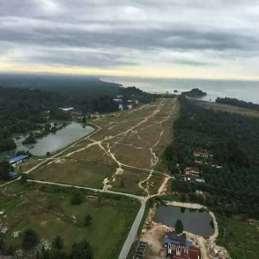
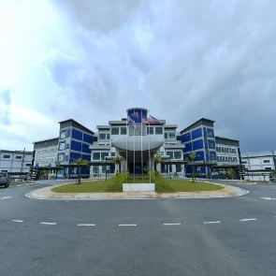
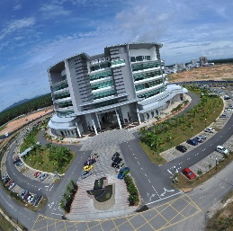
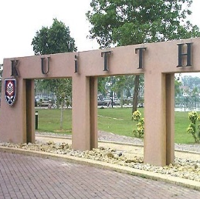
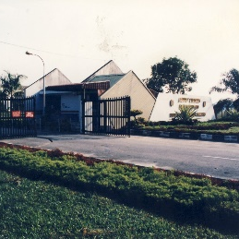
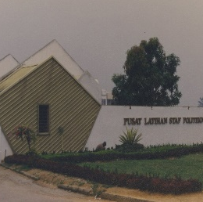
2017
UTHM
UTHM PAGOH
PAGOH
BRANCH CAMPUS
OPENING
MILESTONE
2020
2000
TANJUNG LABUH
KUiTTHO
TANJUNG LABUH
BRANCH CAMPUS
LAUNCHING
KOLEJ UNIVERSITI TEKNOLOGI TUN HUSSEIN ONN
2007
UTHM
Universiti Tun Hussein Onn Malaysia (UTHM), is one of the public universities in Malaysia primarily focusing on Engineering and Technology.
Niche Areas: Sustainable Technology and Transportation
UNIVERSITI TUN HUSSEIN ONN MALAYSIA
1996
ITTHO
INSTITUT TEKNOLOGI TUN HUSSEIN ONN

Slide 10
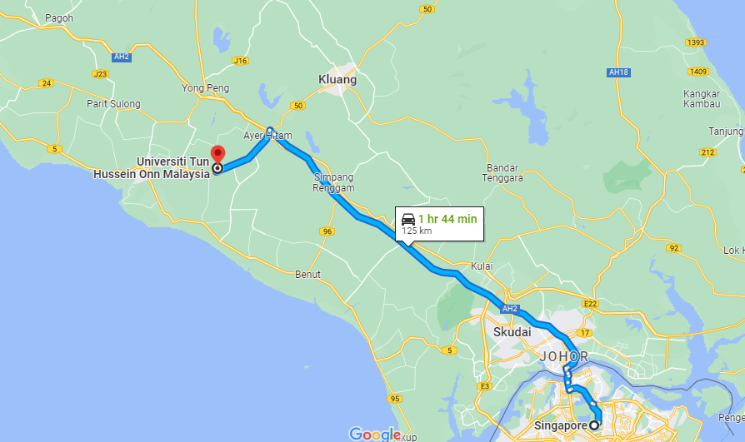

UTHM PAGOH
We are here
STRATEGICALLY LOCATED IN SOUTHERN PART OF MALAYSIA
15 km from North-South Expressway
240 km from KLIA (2½ hours)
100 km from Johor Bahru (1¼ hours)
85 km from Senai International Airport
125 km from Singapore
SINGAPORE

Slide 11
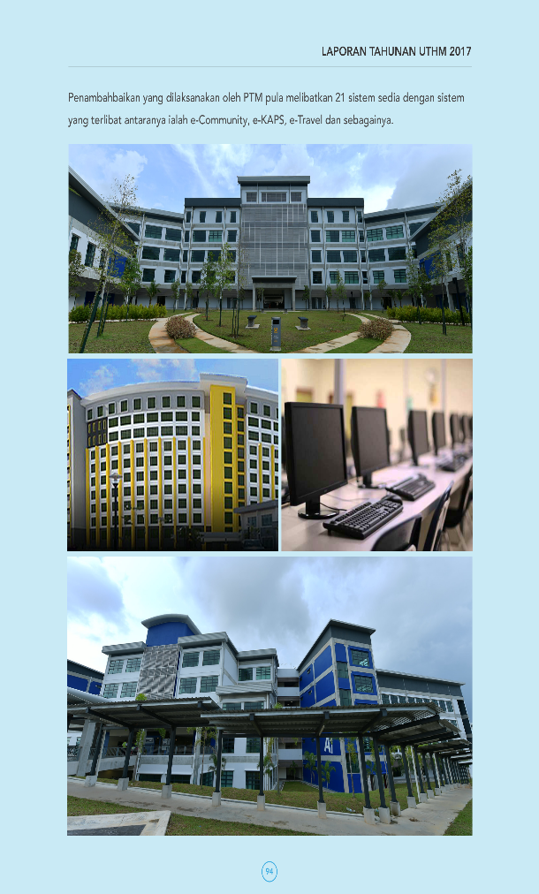

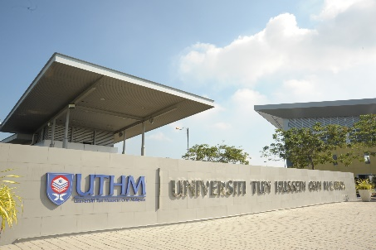
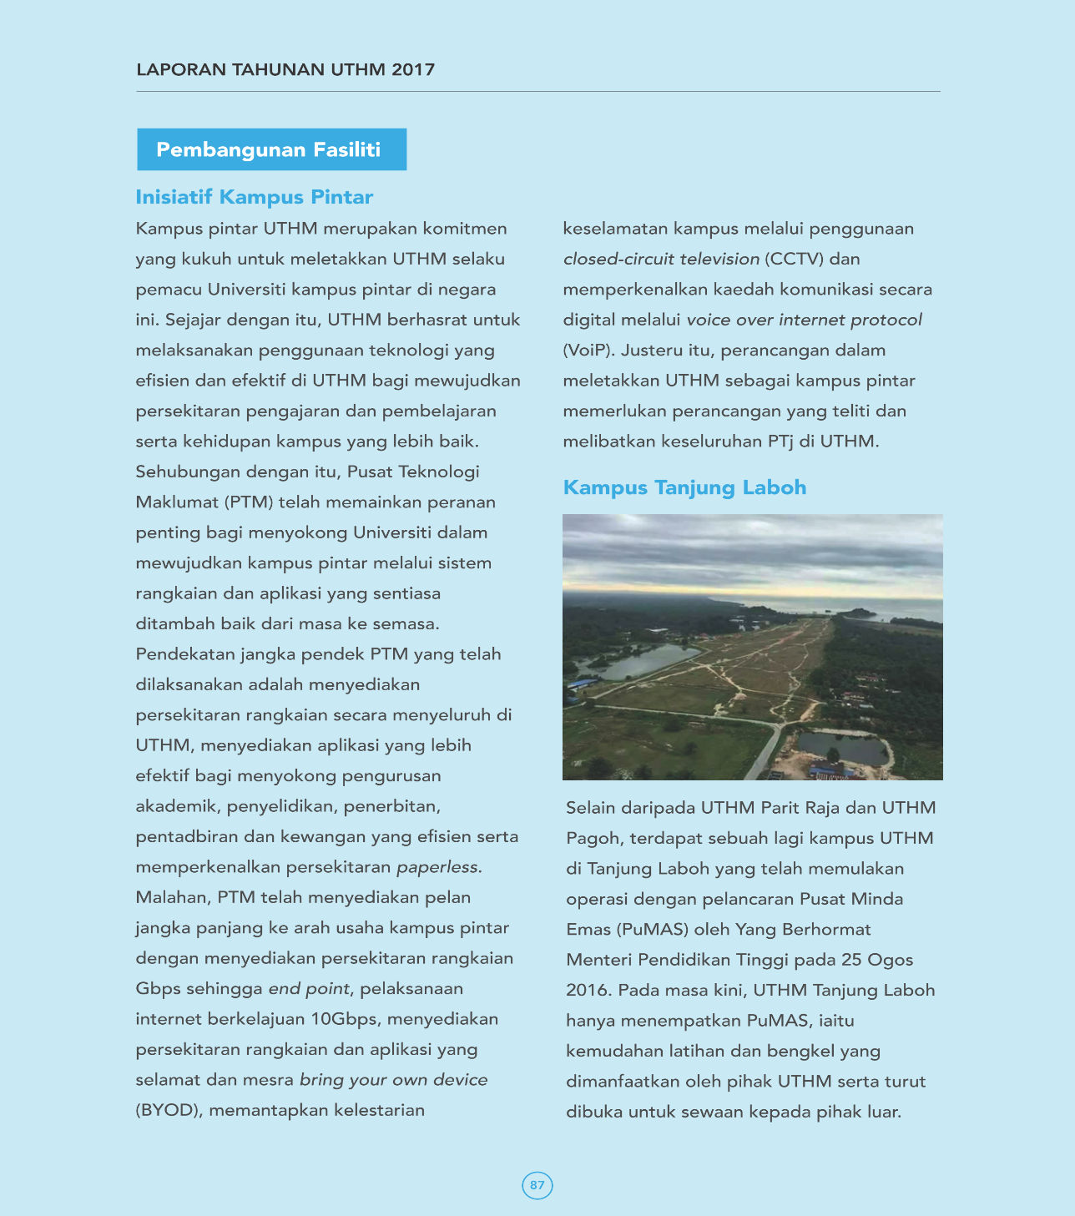
CAMPUSES
Negeri Sembilan
Development = 65.97 acres
Future Use = 104.09 acres
Total = 170.87 acres
Pahang
Malacca
Pagoh Branch Campus
Muar
Batu Pahat
Main Campus
Tg Laboh Branch Campus
Singapore
Development = 376.35 acres
Future Use = 180.37 acres
Total = 556.72 acres
Development = 14.5 acres
Future Use = 312.84 acres
Total = 327.34 acres

Slide 12
WHERE ARE WE NOW

Slide 13








FACT & FIGURE: STUDENTS
36
1074
769
305
Countries
International students
Postgraduates
Undergraduates
number of international students
≈ 93 % of total university’s student population are local.
17,686
UAE
200 students
Indonesia
176 students
Yemen
112 students
Diploma
Bachelor Degree
Master
Doctorate
2,282
12,851
1,277
1,276
China
93 students
Somalia
79
students
Data updated on 1.8.2024

Slide 14


Slide 15
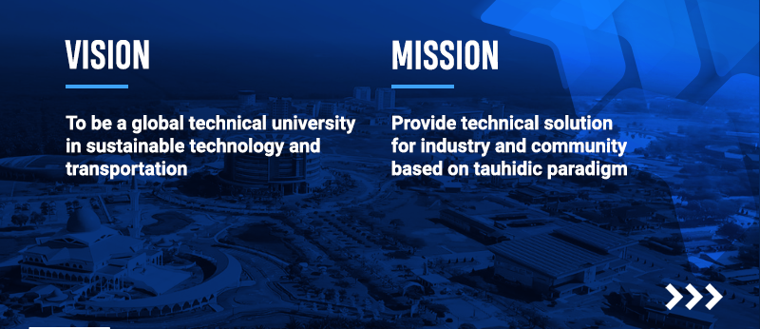

Slide 16
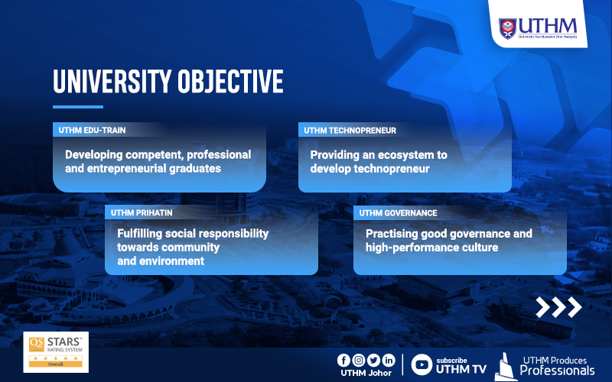

Slide 17
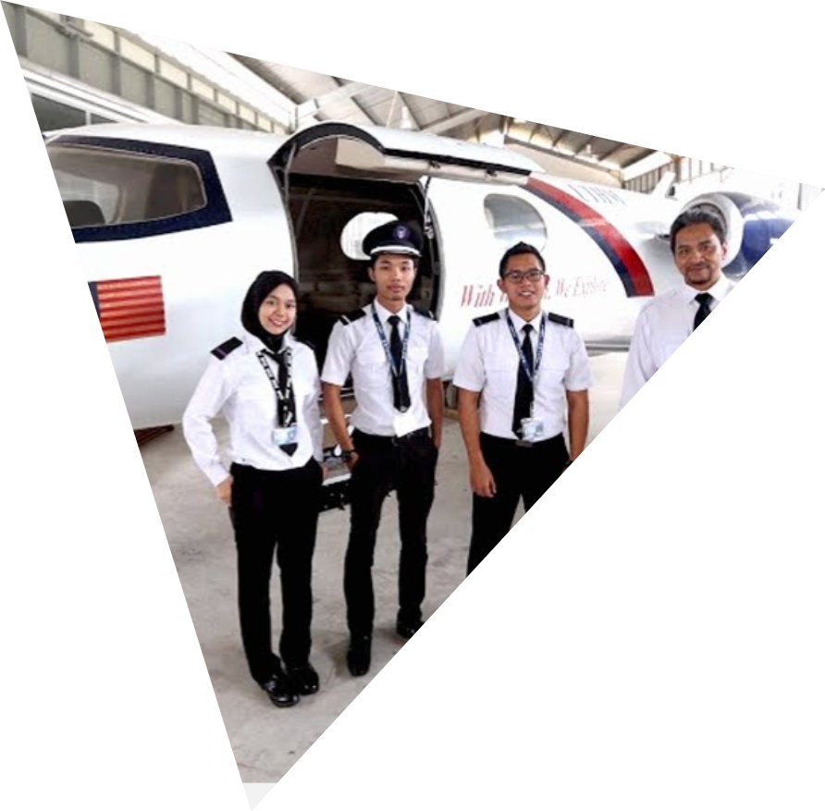
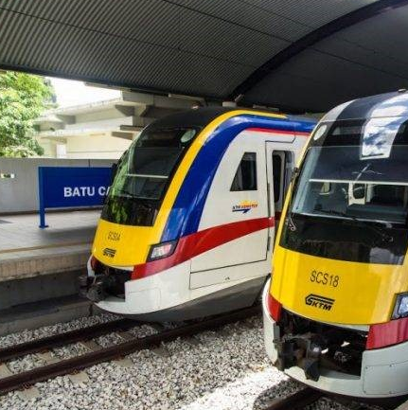
ACADEMIC
8
FACULTIES
Mechanical Engineering
Civil And Environmental Engineering
Electrical And Electronic Engineering
Technology Management And Business
Technical And Vocational Education
Computer Science And Information
Applied Sciences And Technology
Engineering Technology
Centre for Graduate Studies
Centre for Diploma Studies
Centre for General Studies and Co-curricular
Centre for Language Studies
4
CENTRE OF
STUDIES
20
7
56
TVET Programmes
Diploma
ENGINEERING
105
PROGRAMS
52
4
Engineering Programmes
Bachelor Degree
84
33
1
TECHNOLOGY & TVET
Non-Engineering Programmes
PROGRAMMES
Master Degree
PROGRAMS
13
11
46
MANAGEMENT
Doctor of Philosophy
Postgraduates Programmes
PROGRAMS

Slide 18




MALAYSIA TECHNICAL
UNIVERSITY NETWORK
1
2
Sustainable Technology & Transportation
Advanced Manufacturing
and Computing Technology
NICHE
AREAS
4
3
Advanced Process Engineering and Automotive
Electronic and Automation Engineering

Slide 19











UTHM RESEARCH
5 Institutes for Research and Consultation
6 Center of Excellence (CoE)
27 Center of Research (CoR)
119 Focus Group
(FG)
Malaysia Research Institute for Vocational Education & Training (MyRIVET)
Institute for Integrated Engineering (I²E)
Institut Transformasi Sosial dan Pembangunan Wilayah (TRANSFORM)
Institut Ahli Sunnah Wal Jamaah (ISWAJ)
Malaysias Real Estate Institute (MyREI)
FKEE | 2
FKMP | 5
FAST | 3
FKAAB | 4
FTK | 3
FPTV | 2
FSKTM | 3
FPTP | 4
PPB | 1
FKEE | 18
FKMP | 15
FAST | 9
FKAAB | 12
FTK | 13
FPTV | 12
PPUK | 4
PPD | 15
FSKTM | 8
FPTP | 8
PPB | 5

Slide 20





RESEARCH ACHIEVEMENT
in 2023
17
RM17,525,538
NEW research grant secured in 2023
NUMBERS
OF STU /
SPIN-OFF
COMPANIES
RM5,125,410.25
Consultation & testing project
RM1,564,650
Industrial fund & initiative
5
NEW lab for ISO 17025
RECESS, MiNT-SRC, JCR-FKAAB
AMEL-FKAAB, WWEL-FKAAB
+ EMC Center (existing)
1st in UTHM
UTHM Commercial Laboratories

Slide 21
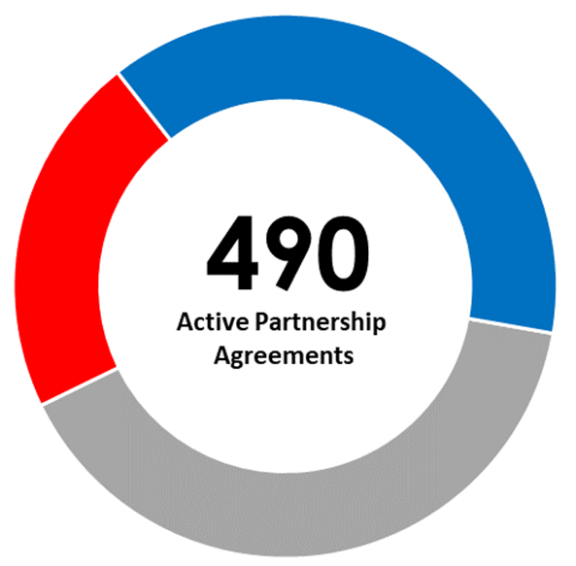
COLLABORATION & PARTNERSHIP
MoA
12%
MoU
Memorandum of Understanding, Cooperation Agreeement etc
Student Exchange Agreement, Research Agreement, Collaboration Agreement etc
48%
825
Instrument
Letter of Intent, Letter of Cooperation, Service Contract, Non- Disclosure Agreement (NDA) etc
40%

Slide 22
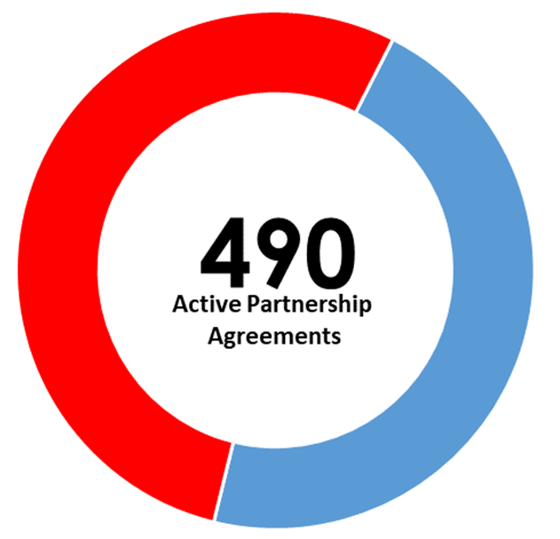
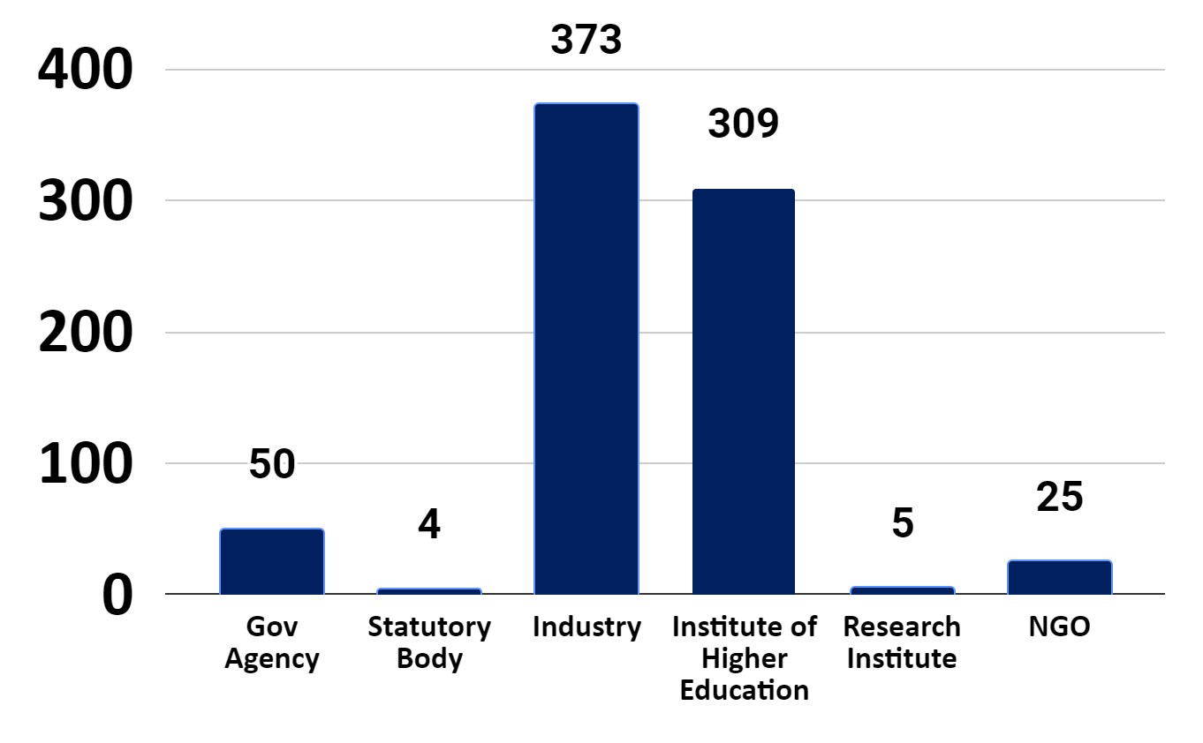
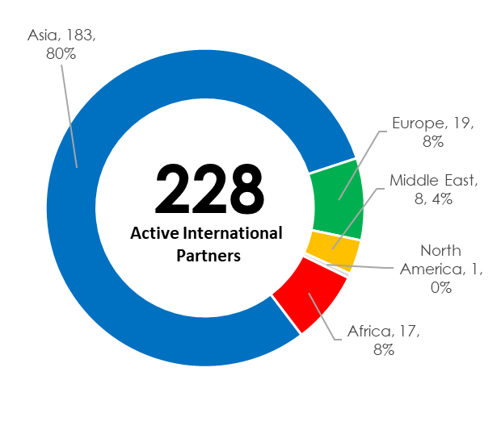
COLLABORATION & PARTNERSHIP
CONT…
NATIONAL
62%
825
INTERNATIONAL
38%
316

Slide 23
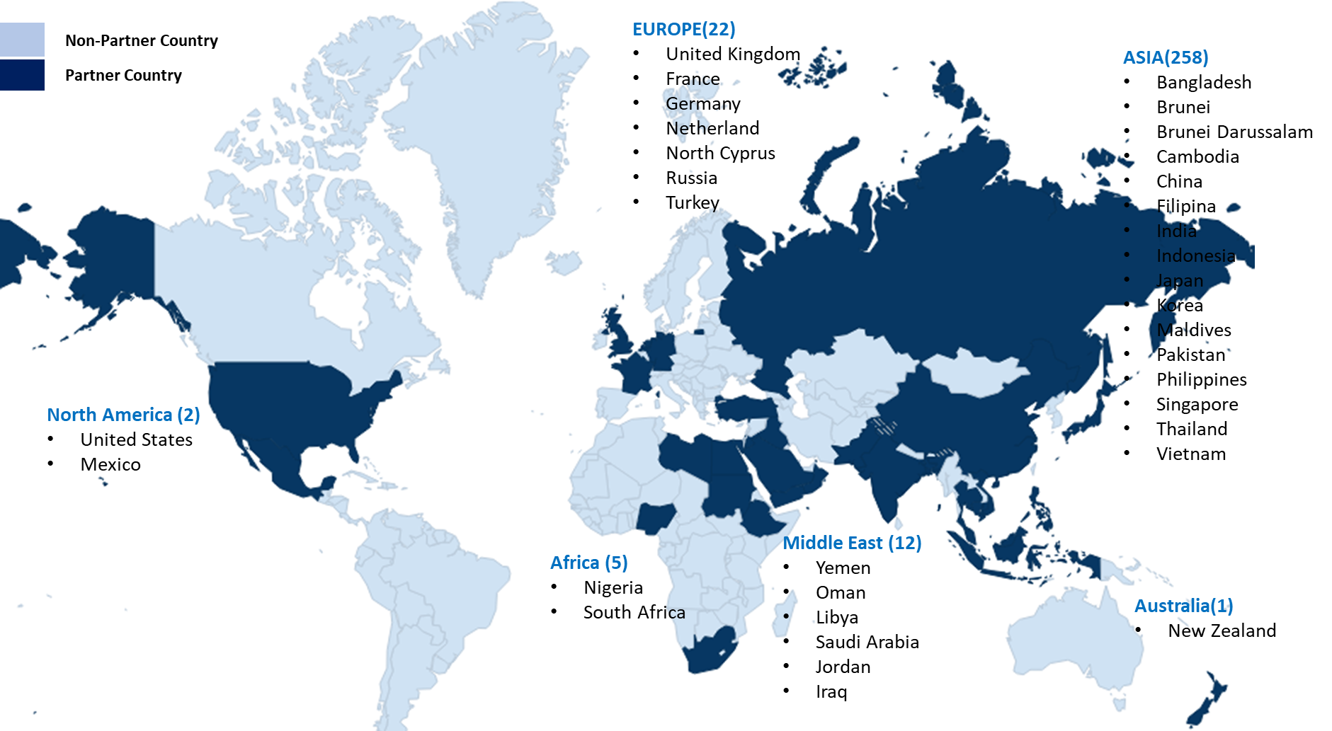
UTHM INTERNATIONAL BILATERAL PARTNERS

Slide 24
ENGAGEMENT STRATEGIES

Slide 25


Industry CeO @ University (ICON) - Industry Professor
Either CeO, MD, President or Chairman of the medium enterprises and above│Improvement of academic program, student development & RDIC│Link UTHM with other industry partners
Main Initiatives
Centre of Industry (COI)
Establish industry center/laboratory within the faculty│Research/Training/Business│High-Impact Knowledge Transfer Programme

Slide 26




Other Initiative
M A T C H I NG F U N D
P H D @ I N D U S T R Y
I n d u s t r y - b a s e d P h D
J o i n t
p r o j e c t w i t h i n d u s t r y
A P E L
A c c r e d i t a t i o n o f P r i o r E x p e r i e n t a l L e a r n i n g
D T D 4 I F
D o u b l e T a x D e d u c t i o n F o r I n d u s t r y F u n d

Slide 27


Slide 28
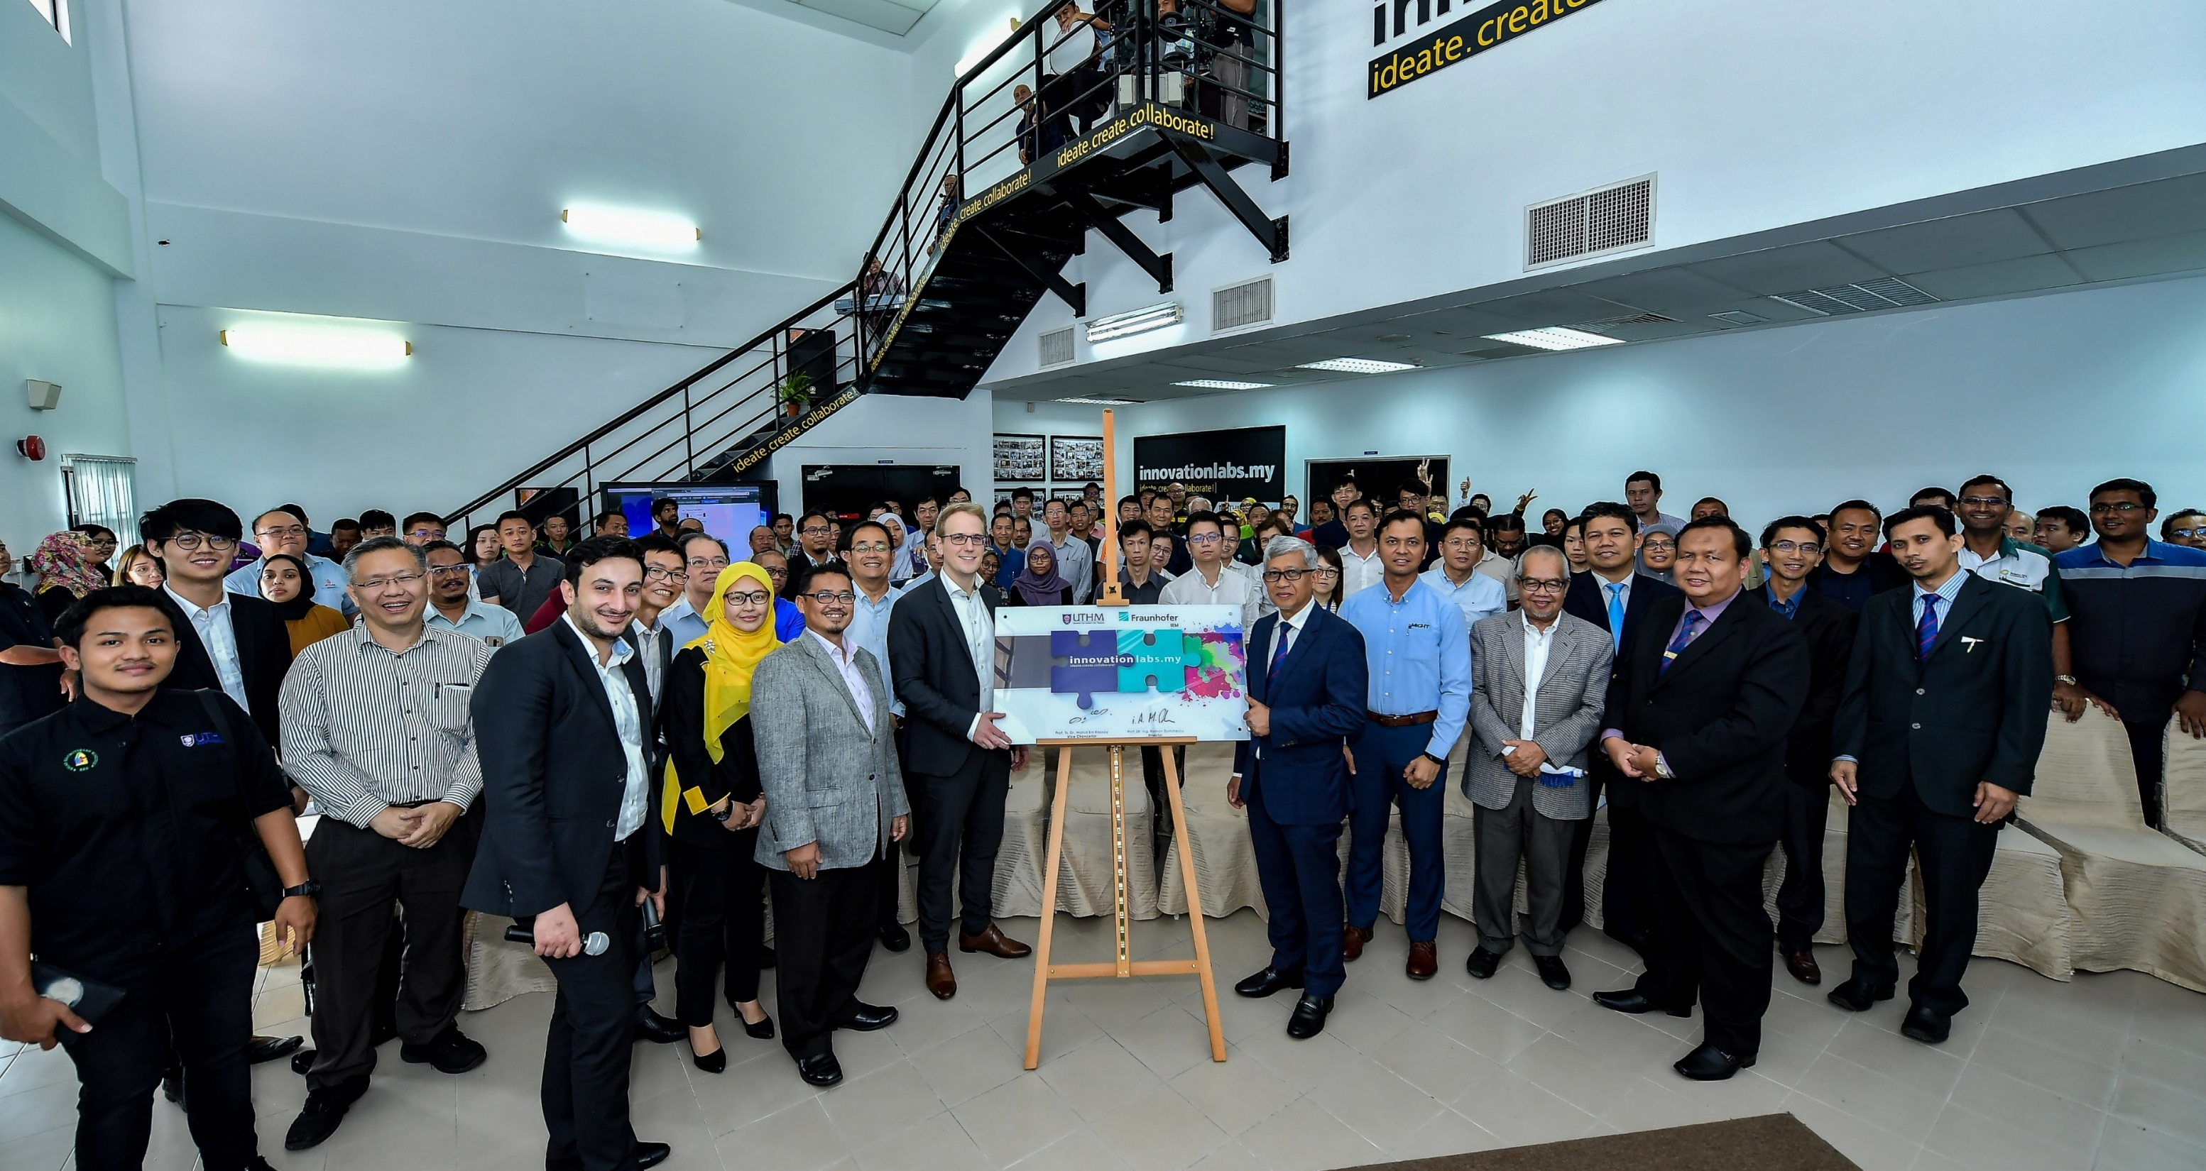
Fraunhofer Innovation Labs
COI

Slide 29
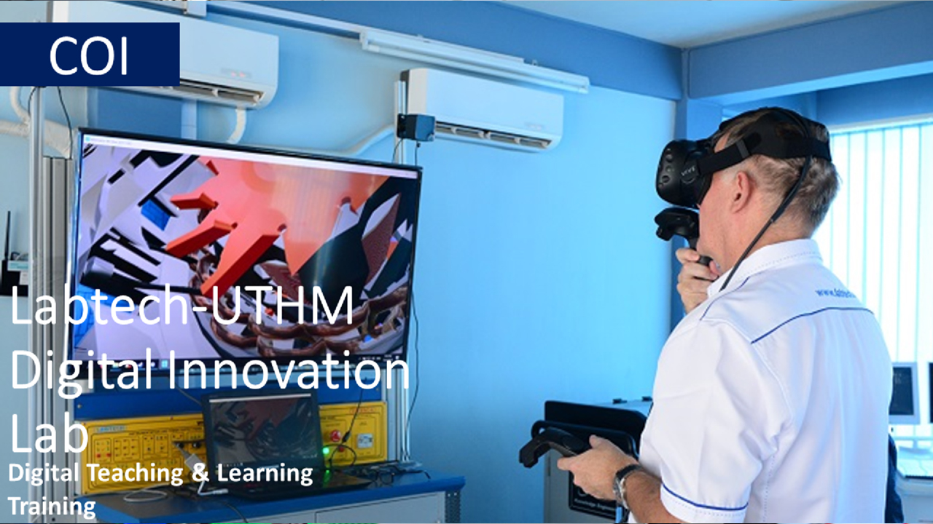

Slide 30
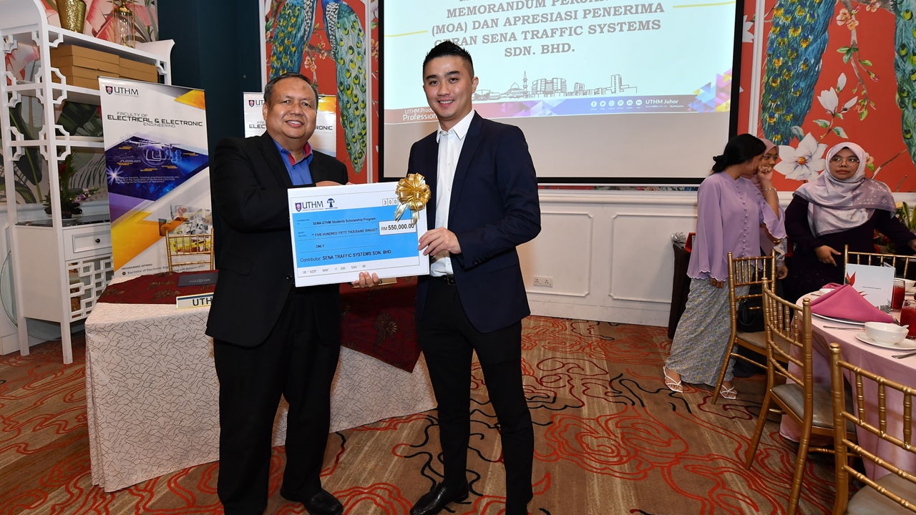
UTHM-SENA Traffic Systems
Intelligent Traffic Solution and Systems

Slide 31
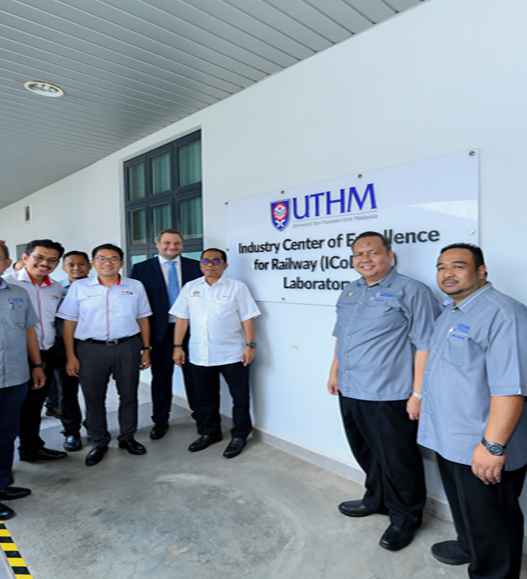
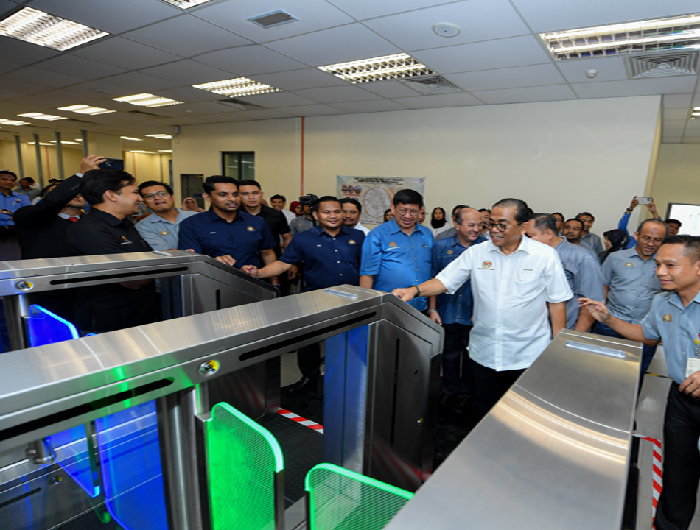
Industry Collaboration Programme (ICP)
UTHM -Indra Sistemas, Prasarana & MRT Corp.
EDEN Railway Signal Link Simulator Lab

Slide 32

Industry Collaboration Programme (ICP)
UTHM -Indra Sistemas, Prasarana & MRT Corp.
Cybersecurity Lab

Slide 33
Thank You

